Slide 1
No one is safe until everyone is safe - global and local governance of COVID-19 vaccination

Slide 2
Why we need equitable vaccine delivery now in Myanmar! - Vaccine equity will accelerate the end of the pandemic - Myanmar location among the world’s populous nations - Myanmar’s complex political emergency amidst COVID - Politics should be kept out of global mechanisms - COVAX

Slide 3
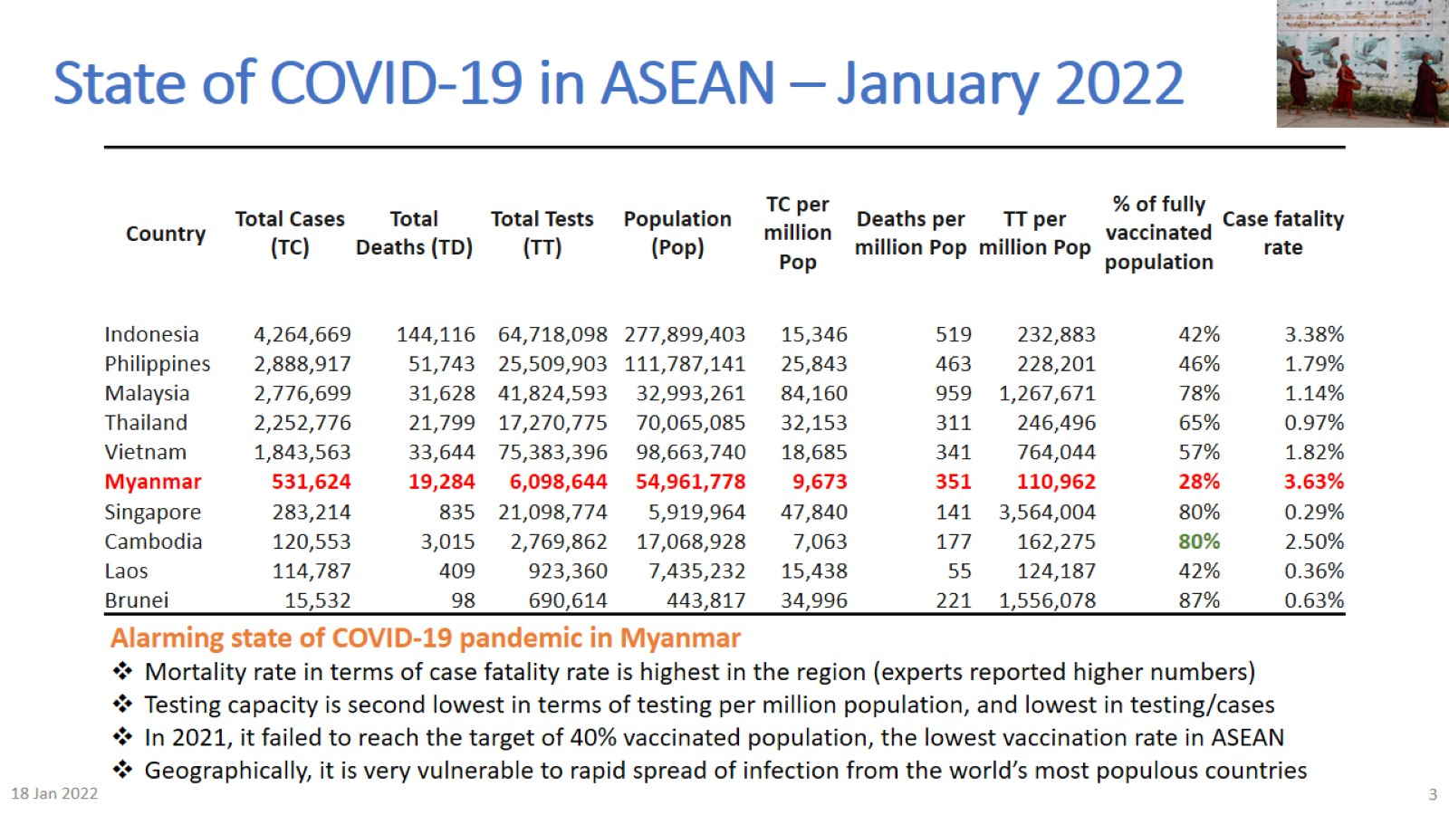
State of COVID-19 in ASEAN – January 2022

Slide 4
Comparing vaccination rates in two LDCs of ASEAN

Slide 5
The problem – Complex political “Pandemica” in Myanmar

Slide 6
Politicization of COVAX delivery – prejudice without precedents

Slide 7
Vaccine communication: Willing but misinformed

Slide 8
Deadly political crisis and a way forward?

