Slide 1
Populism and the COVID-19 Pandemic
Based on a paper by Michael Bayerlein, Kiel University
Vanessa Boese, VDEM Institute
Scott gates, university of oslo &prio
Katrin kamin, ifw, kiel institute for the world economy
S mansoob murshed, iss-Erasmus university and Coventry university

Slide 2
Populism
Populists: will of the people
Many populists: are plutocrats, where plutocratic intentions are combined with nationalistic rhetoric
Rise of populism comes at a time of rising globalization and inequality with both the below median socio-economic classes and even the median voter is immiserised, which is widely cited as the reason for the rise of populism
Populist politicians may be providing (supplying) the nationalistic demands of the immiserised

Slide 3
How are Populist Governments Handling the Pandemic?
Some literature on the differences between the response of autocracies like China and democracies to the pandemic.
But little in the way of populist government responses
Populist governments are not the same as established autocracies

Slide 4
Theory: Strategic Interaction between the Government and Public
The government’s expected utility (U_{G}) may be denoted as:
$U_{G}= π\left(a,e\right)U_{G}^{L}(Y_{G}^{L})+(1−π)(a,e))U_{G}^{H}(Y_{G}^{H})−C(a)$ (8)
where Y^{L}_{G} and Y^{H}_{G} denote ‘pay-offs’ in the low and high state of the pandemic. The pay-offs are greater in the low-state of the pandemic, both for the governments and the public.
${(Y}_{N}^{L}−R^{L})>$ ${(Y}_{N}^{H}−R^{H})$
C is the cost function of undertaking the action, a, which diminishes the chances of a more virulent pandemic, but these actions entail a cost, for example in terms of both expenditures, as well as foregone revenue and rents. Also, π_{a} > 0, but π_{aa} < 0; there are diminishing returns to actions in terms of lowering the chances of a virulent pandemic. Both C_{a} > 0 and C_{aa} > 0, costs of actions to mitigate the pandemic rise monotonically.

Slide 5
Public
Similarly, for the public (P):
$U_{P}=π\left(a,e\right)U_{P}^{L}(Y_{P}^{L})+\left(1−π\right)\left(a,e\right)U_{P}^{H}(Y_{P}^{H})−E(e)$ (9)
With ${(Y}_{M}^{L}−D^{L})>$ ${(Y}_{M}^{H}−D^{H})$
Where, D is the disutility from the risk of infection, the representative private agent receives median income (Y_{M}), which is lower when the pandemic is more severe due to reduced employment opportunities, E is the cost of effort, e, which increases the probability of a less severe pandemic, π. Also, π_{e} > 0, but π_{ee} < 0, E_{e} > 0, and E_{ee} > 0. Pay-offs include not just a pecuniary component, but also a measure of the psychic costs of bereavement, as well as the disutility of confinement during lockdowns which lower the severity of the pandemic.
Both the government and private individuals maximize the benefit of their action and efforts to lower the severity of the pandemic bearing in mind the cost of actions and efforts.

Slide 6
Reaction Functions
A spike in the infection rate R shifts the government reaction function outwards along the public’s reaction function with a new equilibrium at point B indicating more strategic actions and efforts by both government and public. In the case of populist led governments with greater lockdown aversion, this response may, however, be delayed and the magnitude of the shift could be smaller if the actions undertaken by the state are less rigorous, implying that the new point B, is somewhere to the left and below the point indicated with less preventive behavior on the part of both government and individuals.

Slide 7
Empirical Hypotheses
Hypothesis 1: Populist governments are less invested in far-reaching policy responses to
contain a pandemic shock.
• Hypothesis 2: In a populist political environment, citizens are less likely to exert high
eort to limit the spread of the disease.
• Hypothesis 3: Severity of pandemic is jointly determined by citizen eort and government
policy response.
• Hypothesis 4: The fallout of the pandemic is worse in populist governed countries.
Michael

Slide 8
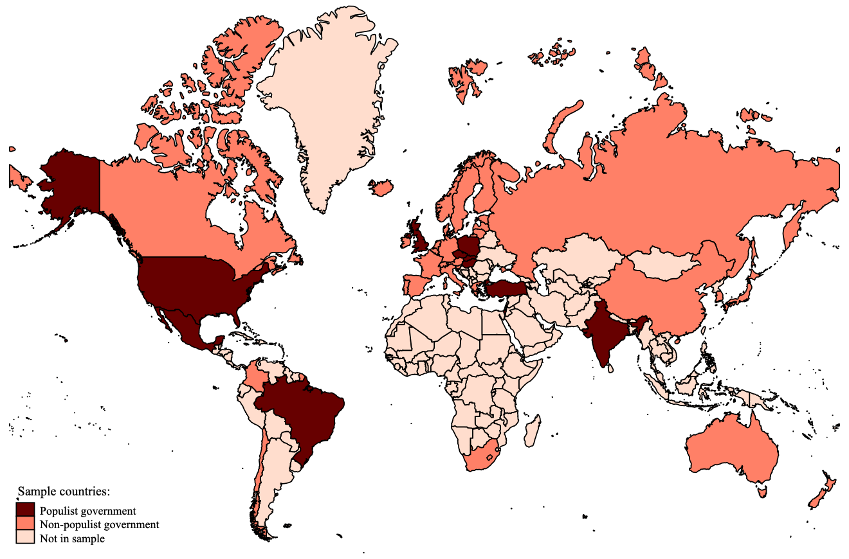
Empirical Design
Sample: 42 developed and developing economies
Data:
Populist government from PopuList and other sources
novel data on government response (Oxford COVID-19 Response Tracker),
citizen behavior (Google COVID-19 Mobility Reports),
and the country-specific severity (excess mortality) of the pandemic.

Slide 9
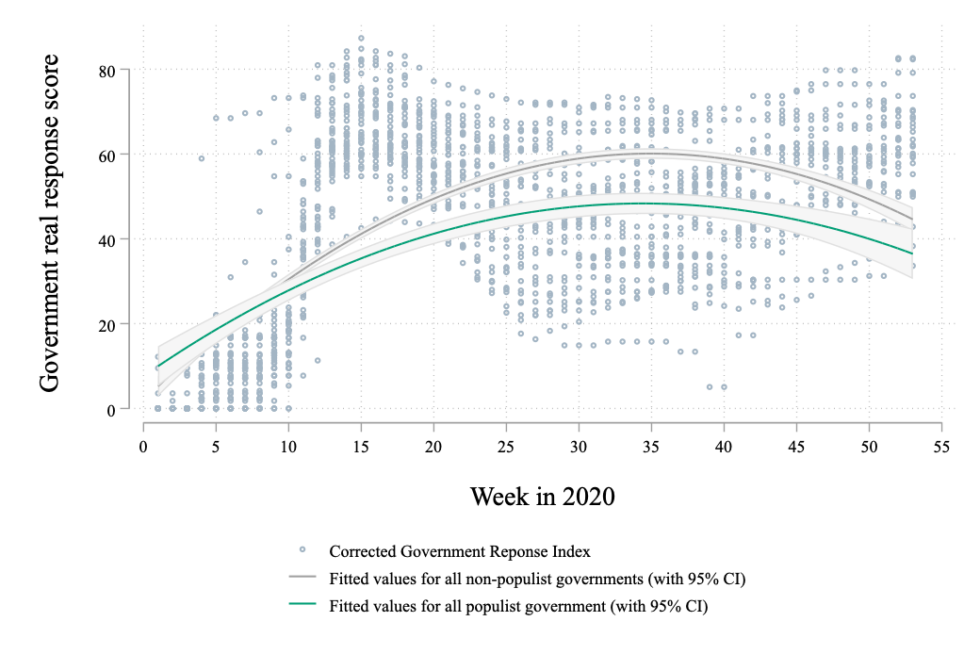
Descriptives: Policy response

Slide 10
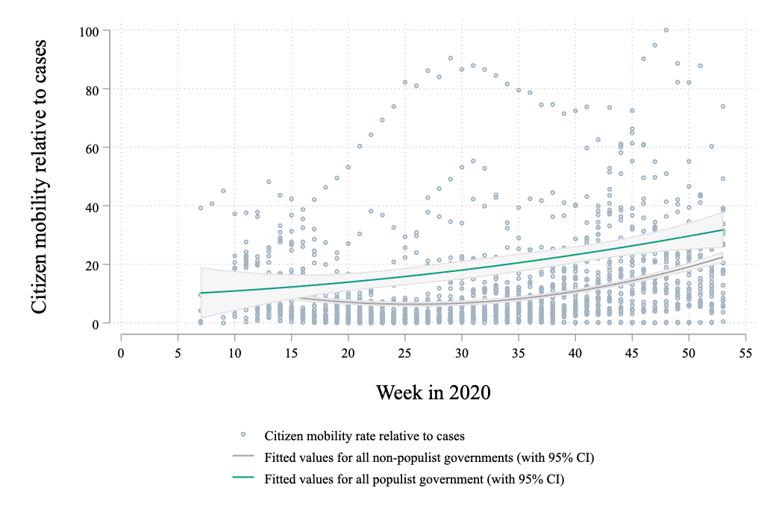
Descriptives: Citizen mobility

Slide 11
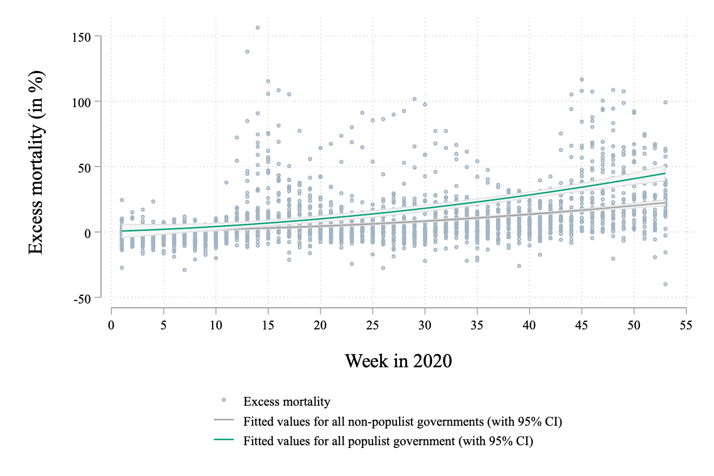
Descriptives: Excess mortality

Slide 12
Conclusion
Our econometric analyses and robustness checks confirm the following:
Current Pandemic is worse with populist governments in charge
At least in 2020

Slide 13
Your best quote that reflects your approach… “It’s one small step for man, one giant leap for mankind.”
- Neil Armstrong

